Slide 1
System Identification of an Autonomous Underwater Vehicle
By: Evan Olson and Vishal Doshi

Slide 2
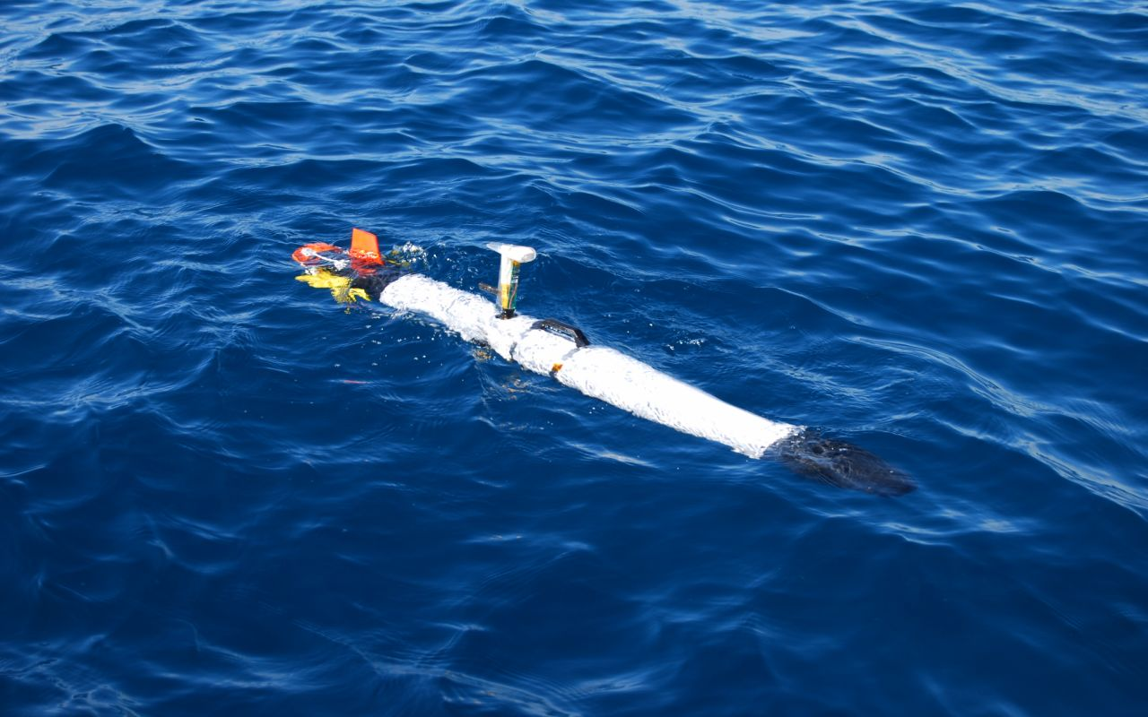
Introduction
Autonomous Vehicles allow expanded capabilities over manned data collection
Relatively low cost, versatile and robust
Ocean Server’s IVER2 Autonomous Underwater Vehicle (AUV)
Image Courtesy: Ocean Server

Slide 3
Objectives
Create a versatile platform for underwater sensing
Mapping
Water profiling
Autonomous navigation
Modify existing IVER2 platform
Add Cameras
Add Sensor Suite
Custom Motion controller

Slide 4
Iver2 Capabilities
Vehicle Size: 5.85 inch diameter; 60” length; 40-50lbs displacement
Endurance: 10 hours at speed of 2.5 kts
Speed Range: 1-4 kts
Control: Four independent control planes, movable internal ballast
External Hook-up: Data - wireless 802.11g Ethernet (up to 1 km comm. distance) Power - 2 pin DC charge voltage in
Navigation: Dead reckoning; Differential GPS (when on the surface)
Tracking: Internal data log – programmable resolution
Software: Windows XP Pro, GUI-based Navigation Suite Mission Planning Software
Energy: 570 WHrs of rechargeable Lithium-Ion batteries (>300 cycles)
Onboard Electronics: SBC with low power X86 processor, 512 MB Memory
Communication: 2.4 GHz radio link when surfaced to download missions and upload collected data; Acoustic modem option

Slide 5
Modifications
Pictured above are the two additions that were added to the IVER2 platform. To the right: Ocean Servers Sonde (Courtesy: Ocean Server). To the left: Nosecone Extension.

Slide 6
Modified AUV
This is the IVER2 platform with the modifications attached. These modifications change the dynamics of the vehicle.

Slide 7
Method
In order to account for the additions to IVER, a new systems identification needed to be performed.
This was accomplished in a series of steps
Collect data set from unmodified AUV
Create a controller and compare to built in controller
Collect data for modified AUV
Create new controller

Slide 8
Results
Due to time constraints and several setbacks only the initial data set was collected.
System identification done in MATLAB and SIMULINK.
Controller was designed and is currently in the process of being implemented on the AUV.
Controller gives large improvements in response.

Slide 9
AUV Response

Slide 10
Conclusions
Initial results are promising.
There is still a large amount of work to do.
Test controller
Collect modified dataset
Design new controller
Implement and test

Slide 11
Testing Video

Slide 12
Questions?

